Slide 1
MODPATH
Particle Tracking for MODFLOW Models

Slide 2
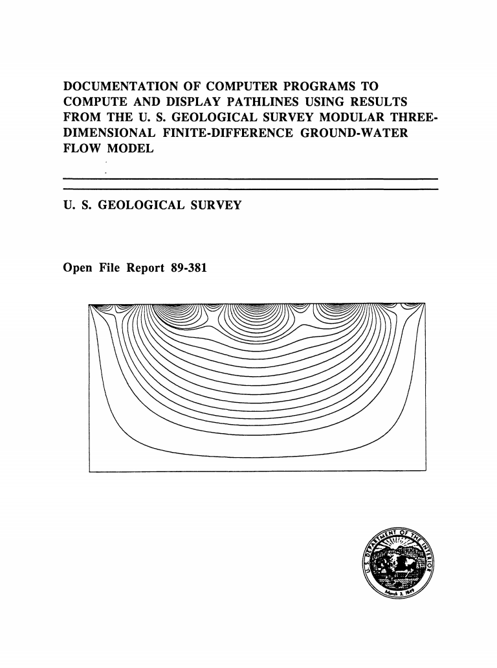
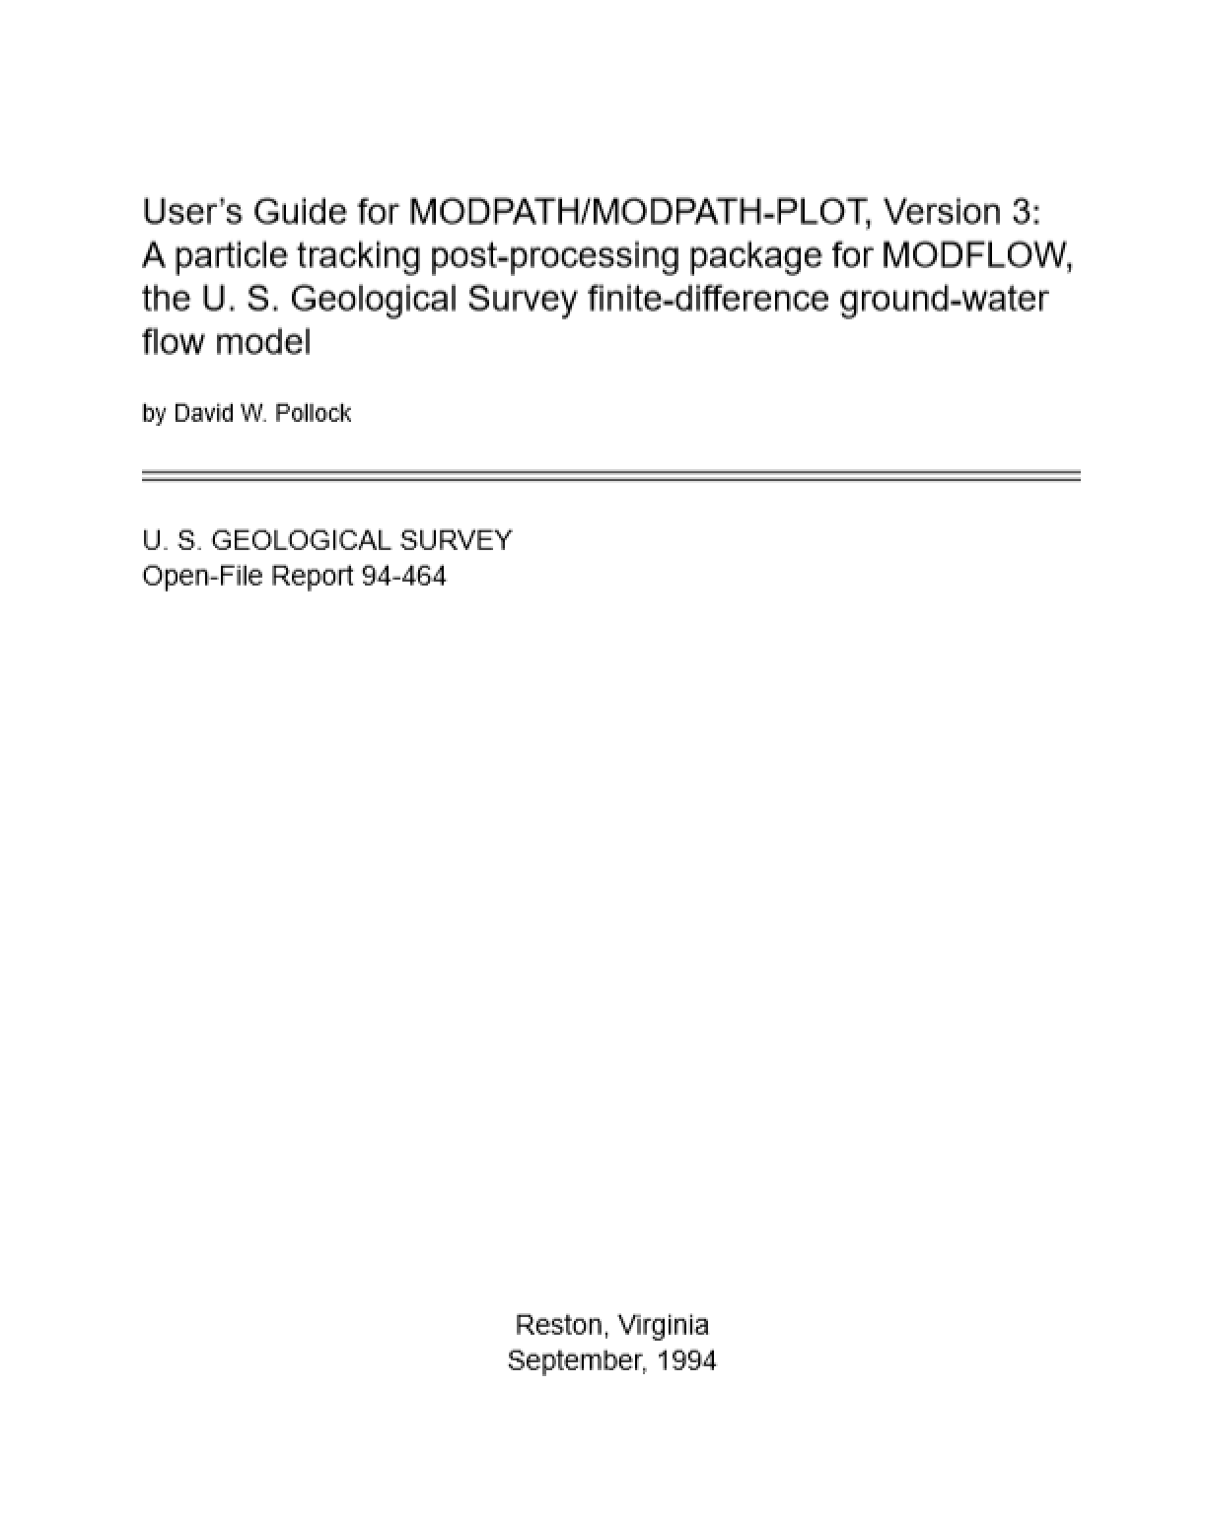
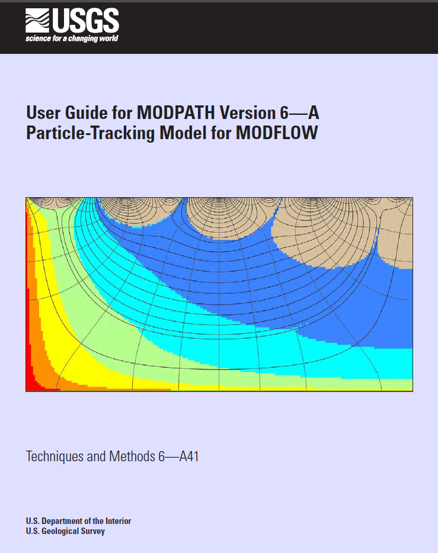
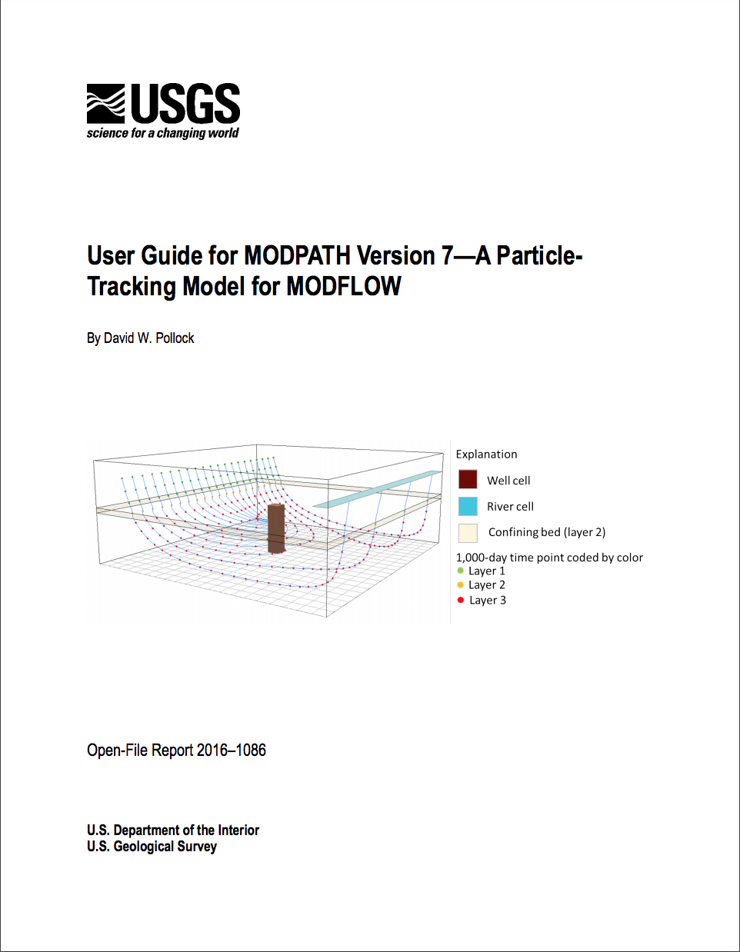
Versions
Version 1, 2
Version 3, 4, 5
Version 6
Version 7
Steady State
Transient
Code Redesign
Unstructured Grids

Slide 3
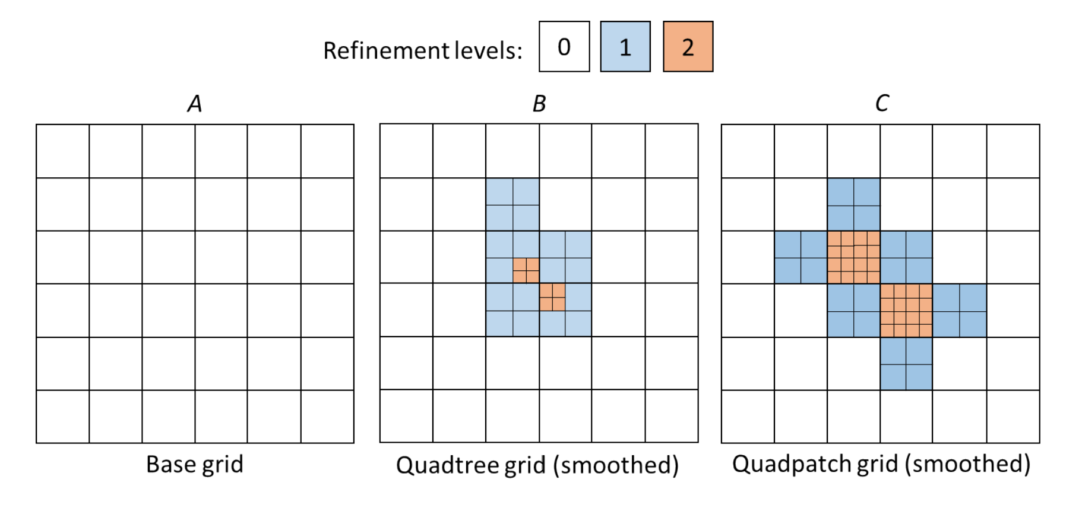

Slide 4
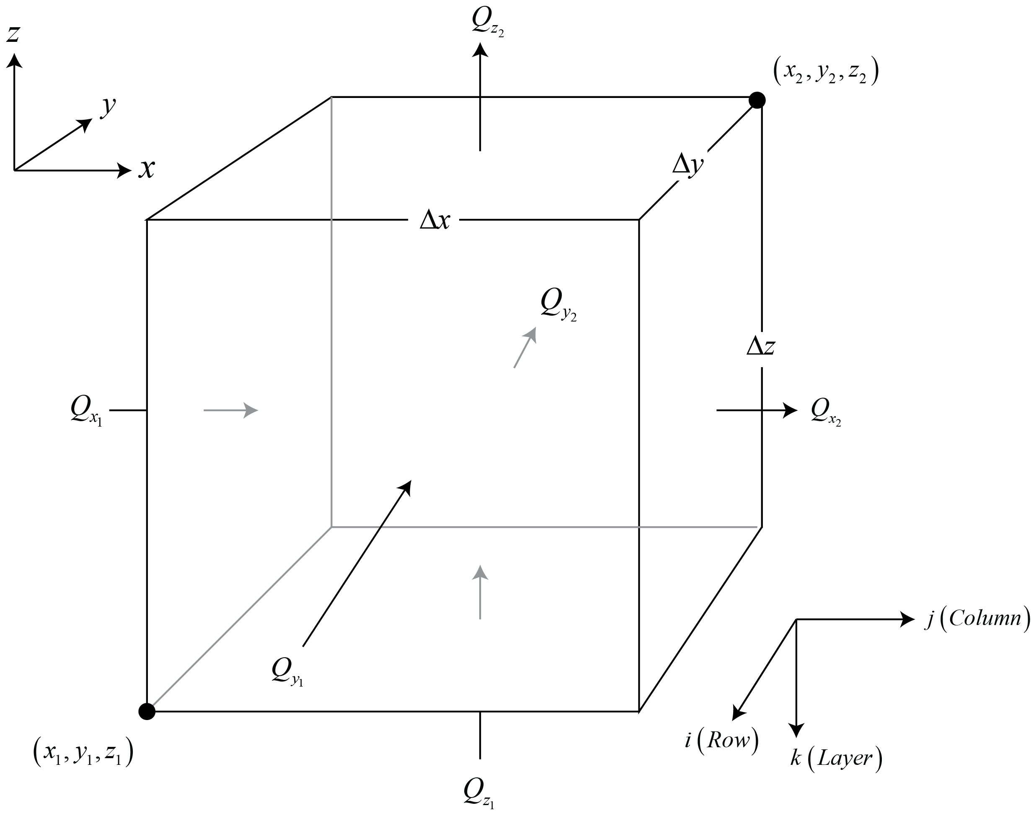
Cell-by-Cell Output from MODFLOW is used by MODPATH
The volumetric flow rates across the six cell faces are obtained from MODFLOW output saved in the cell-by-cell budget file.

Slide 5
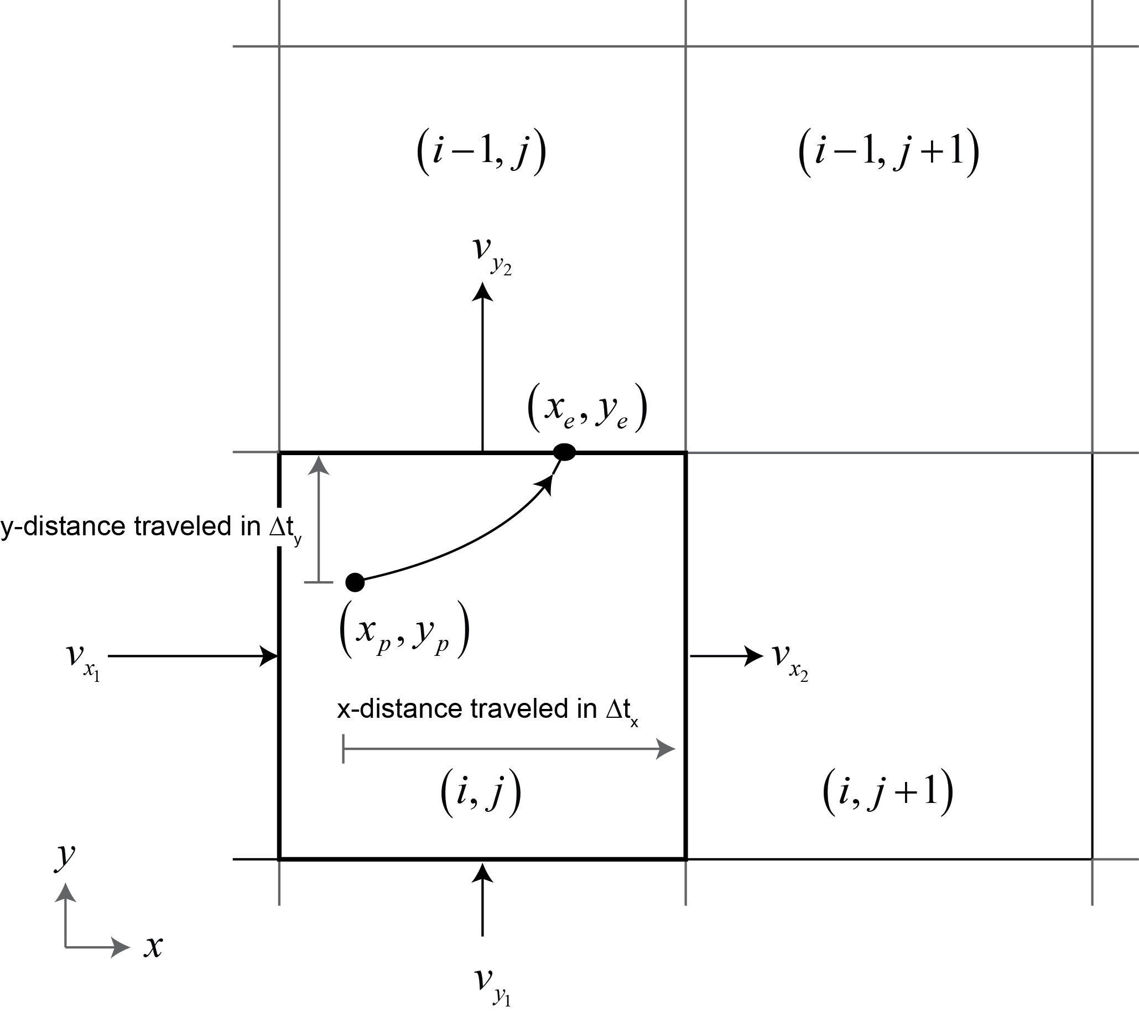
Particle Tracking Through a Grid Cell
Velocity components at each cell face are calculated from the MODFLOW budget rates by dividing them by the cell face area and the porosity
Velocity components are interpolated linearly within a cell
Particle paths are integrated analytically within each cell

Slide 6
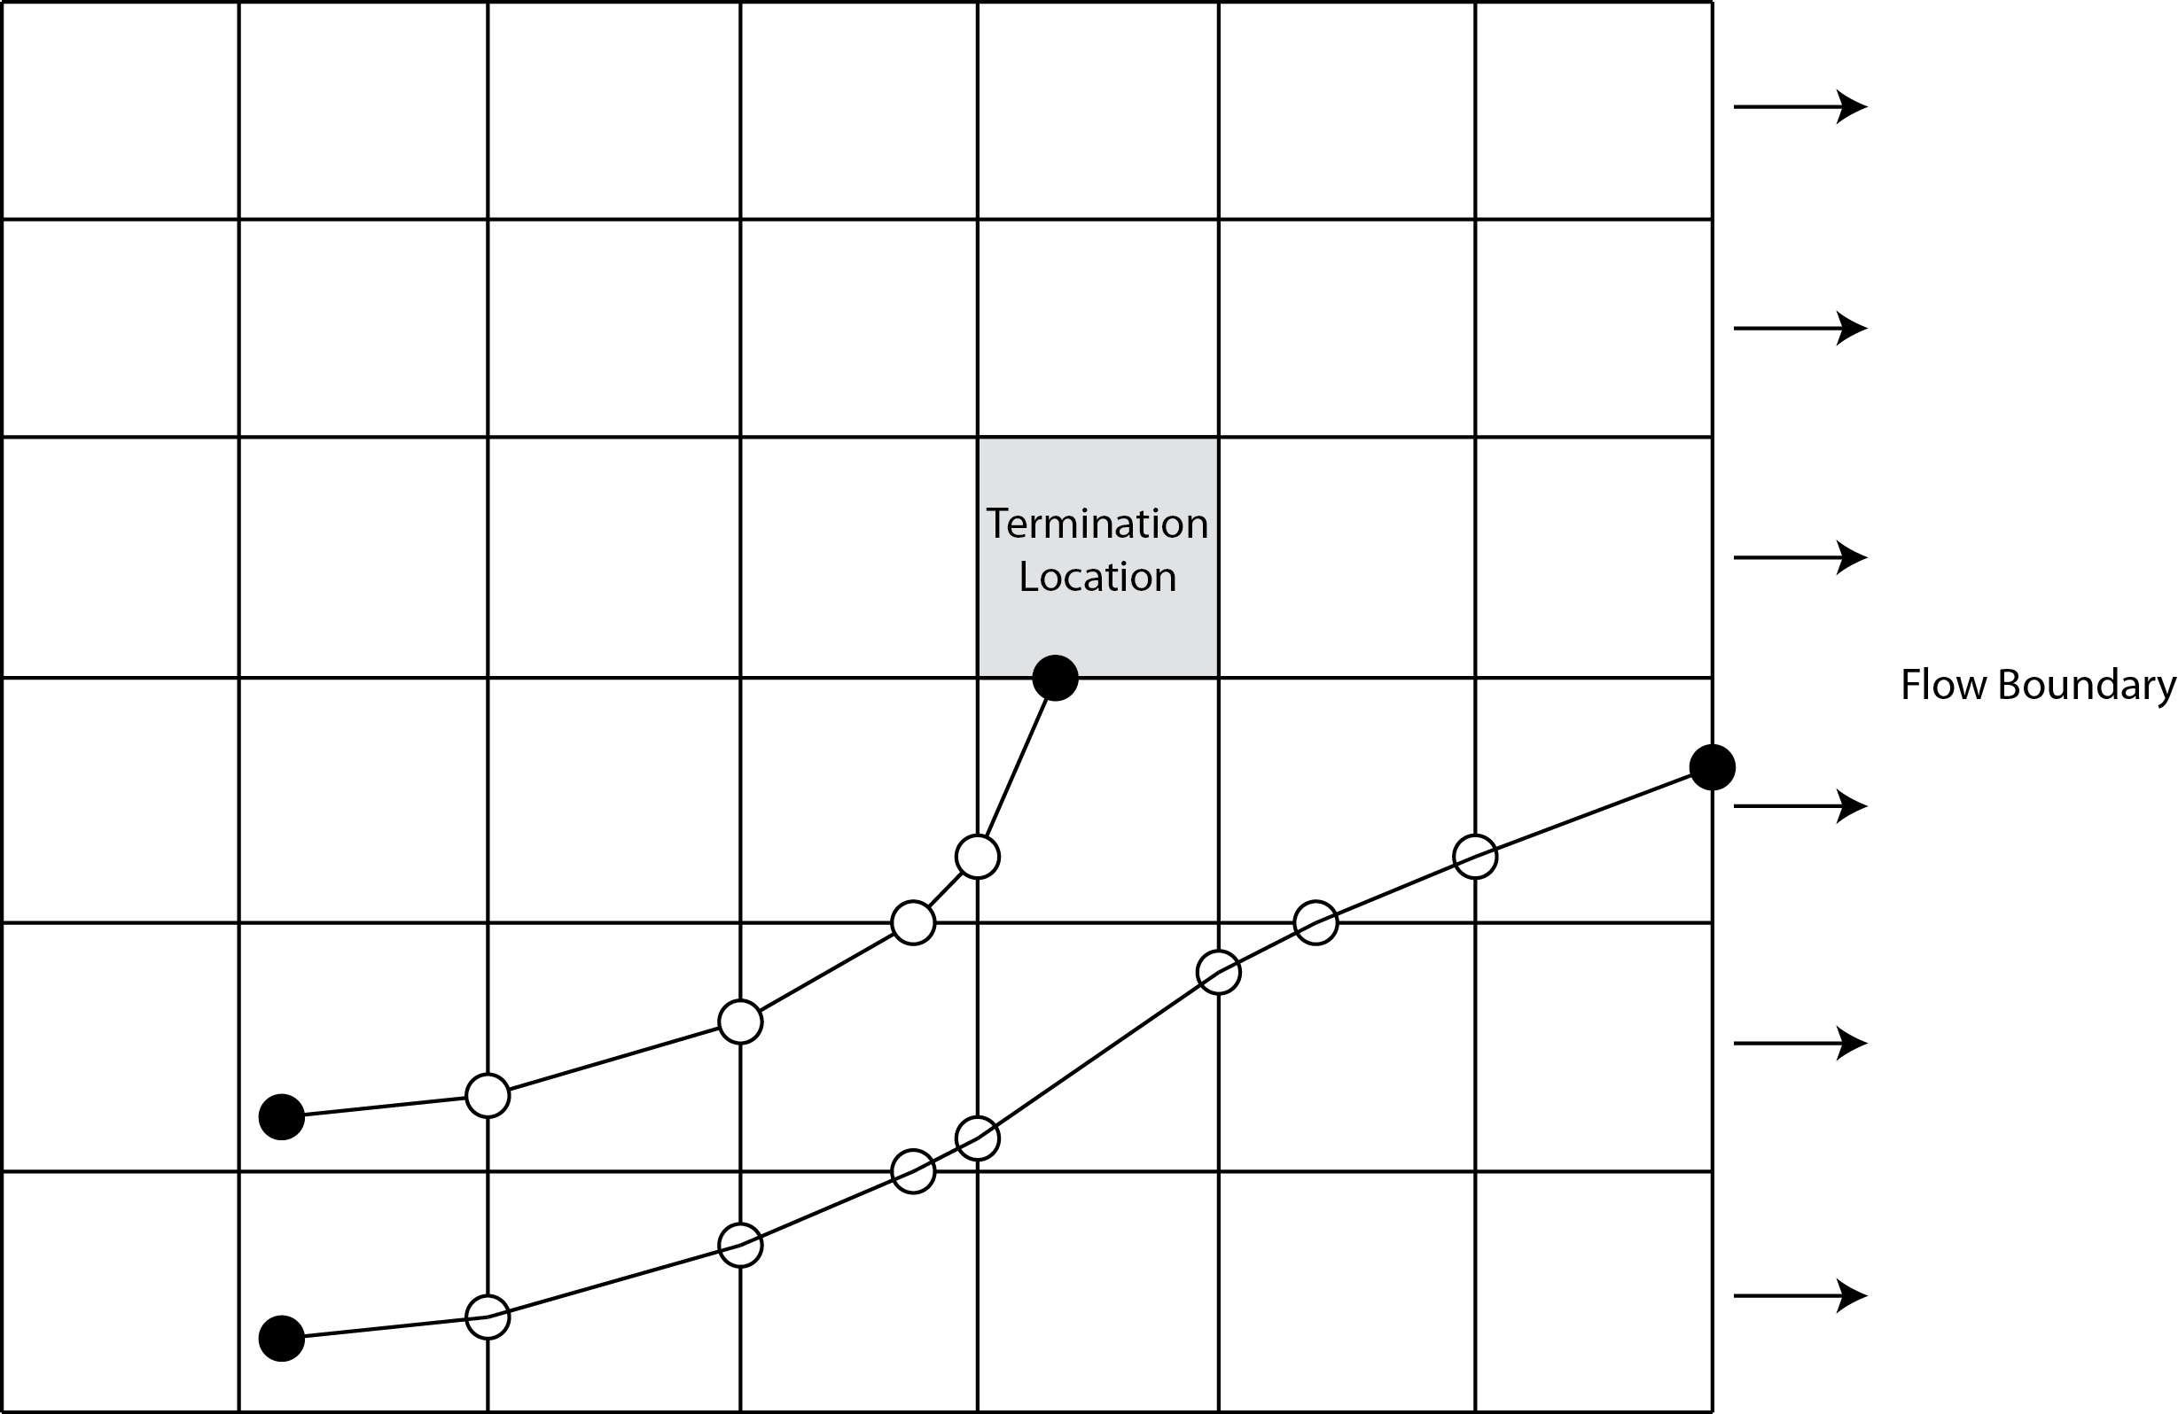
MODPATH Moves Particles Cell to Cell

Slide 7
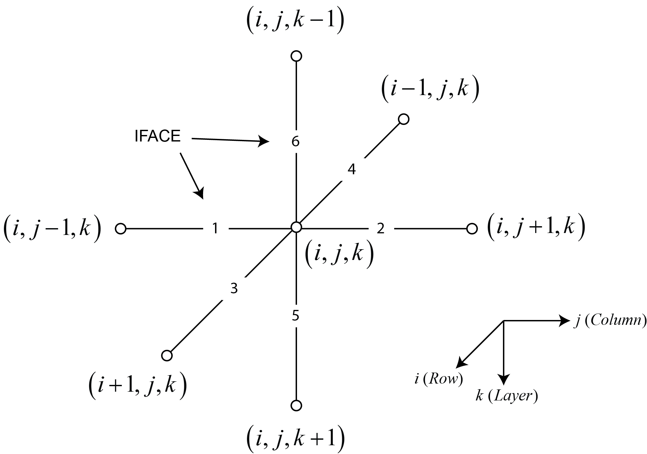
Specifying Boundary Face Flows
Flows from MODFLOW stress packages often represent boundary conditions at cell faces
To compute accurate velocities in MODPATH it is necessary to specify which faces have stress package boundary flows
The variable IFACE is an integer flag that indicates which face to associate with a stress package boundary flow

Slide 8
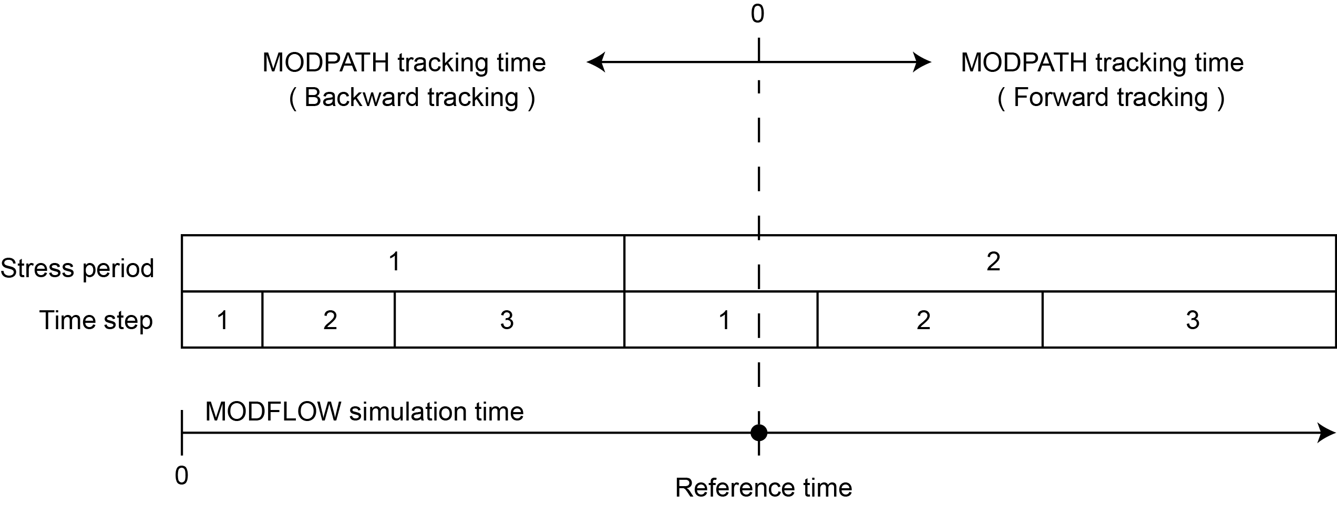
Time Concepts in MODPATH

Slide 9
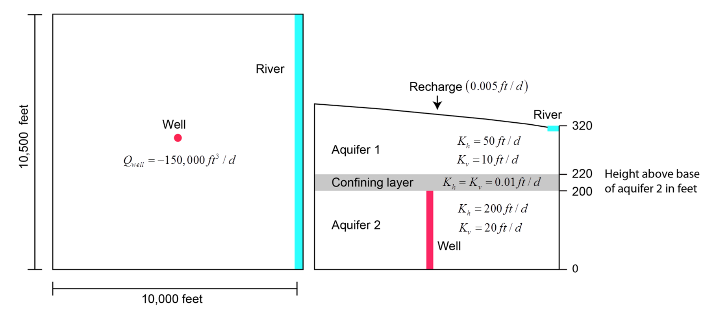
Example

Slide 10
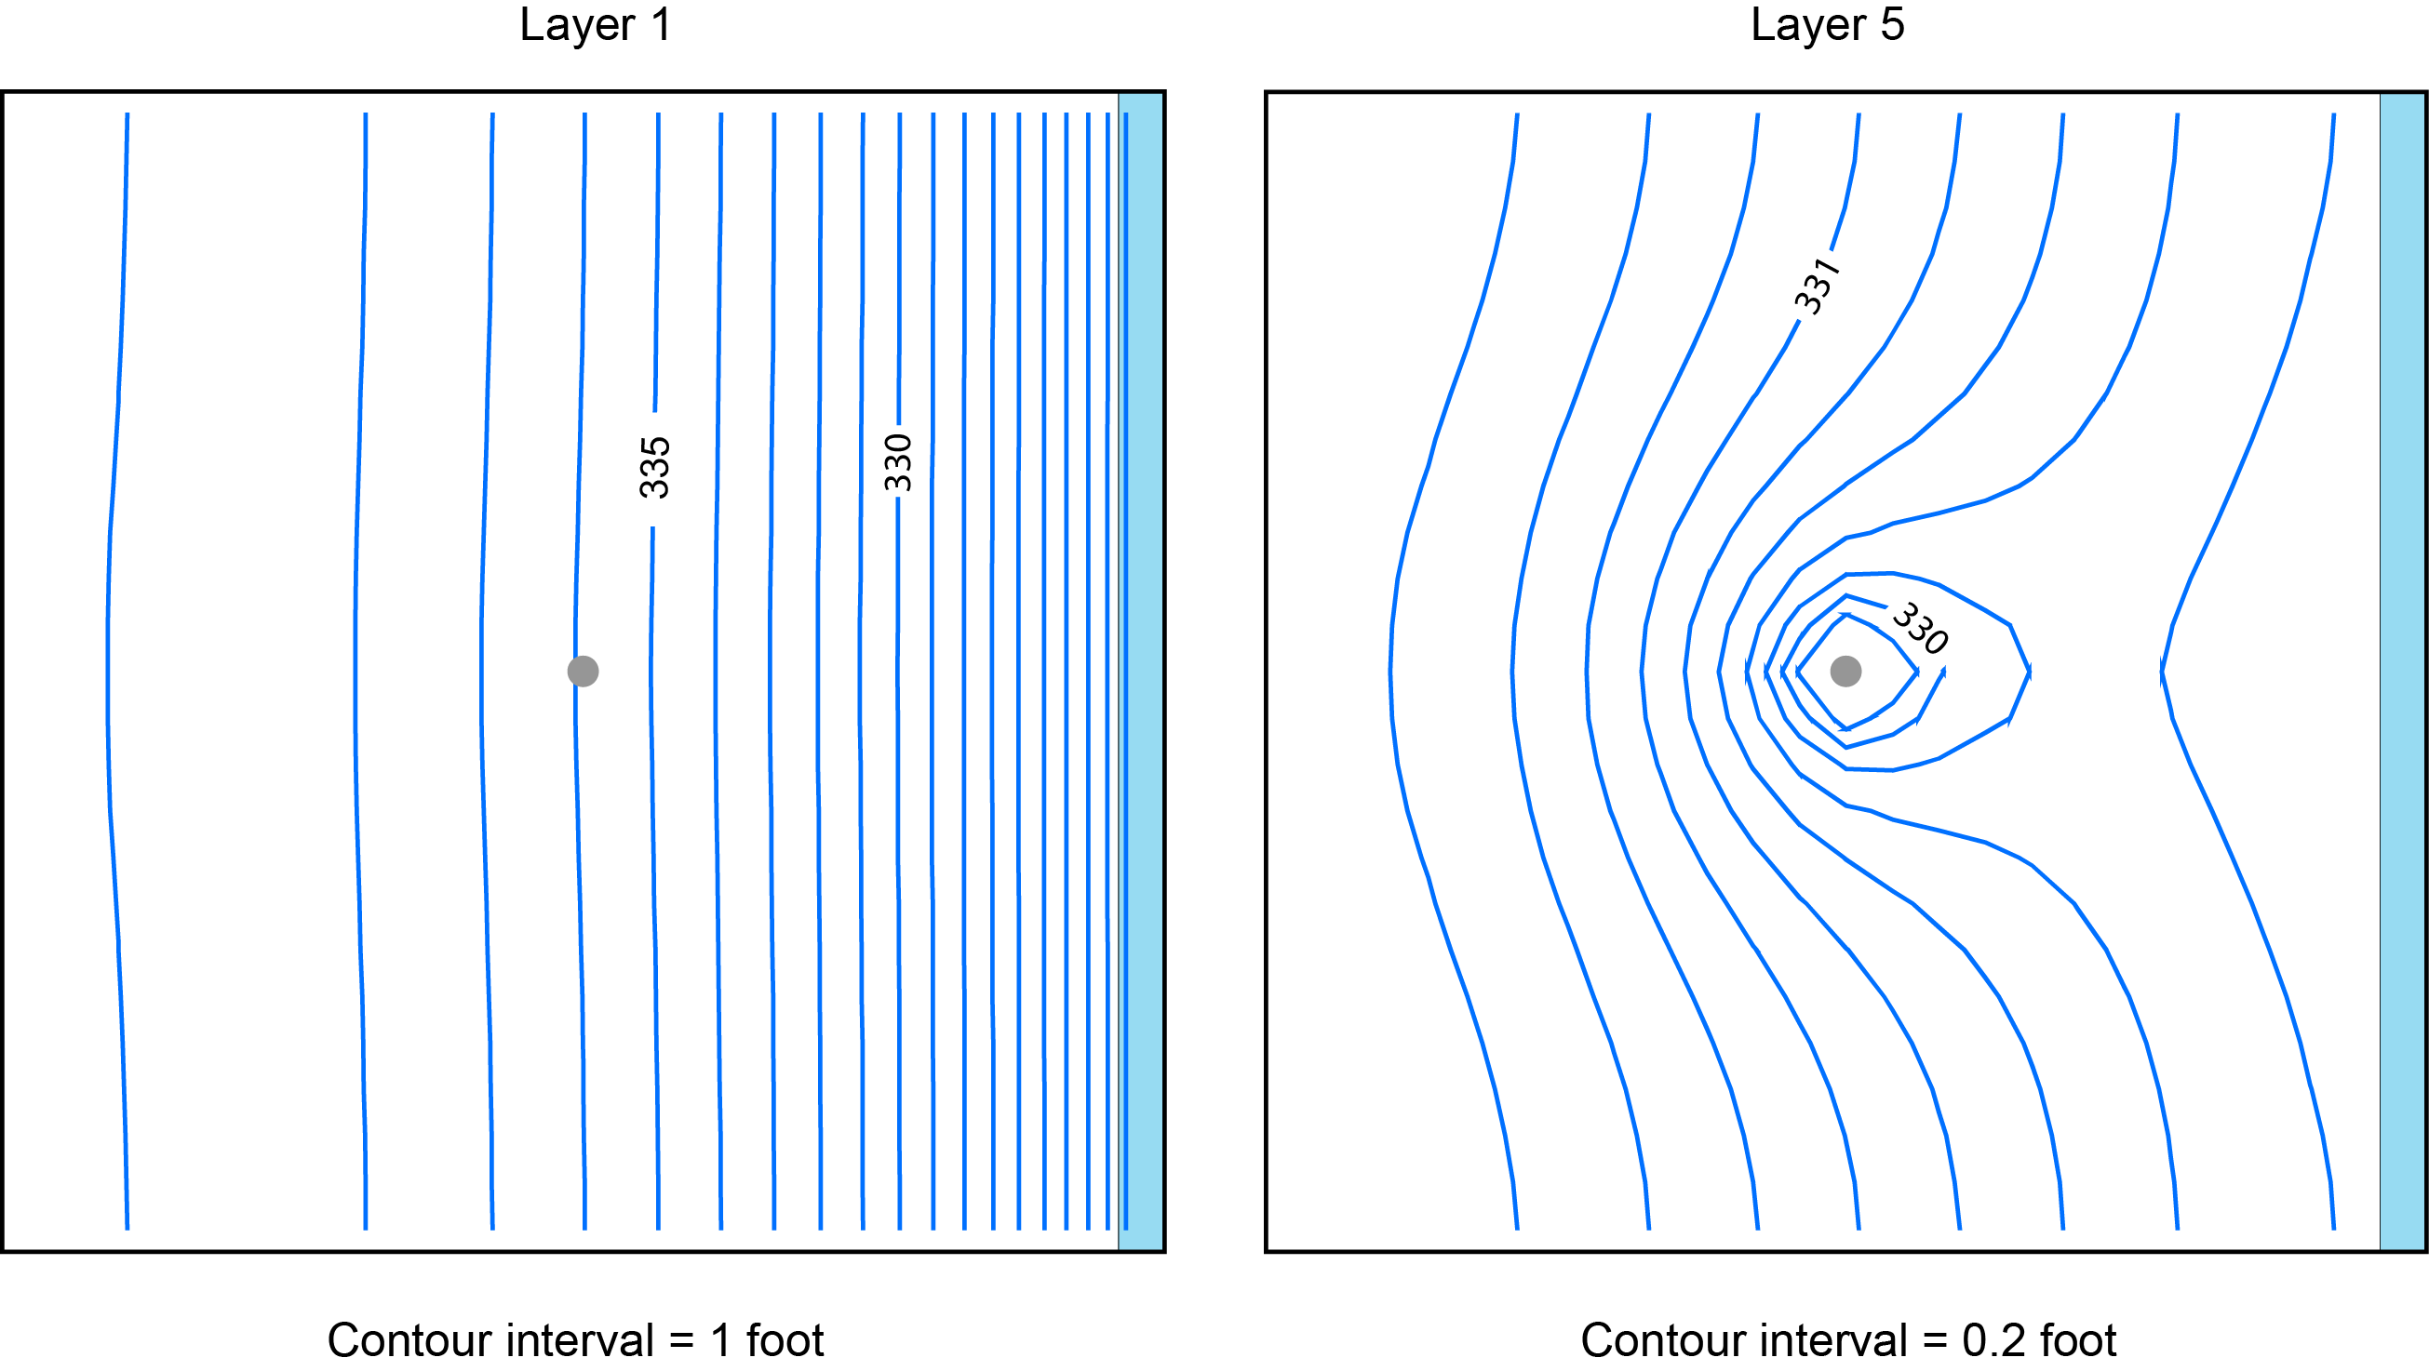
Head in Layers 1 and 3

Slide 11
Output Options
Endpoint simulation produces an endpoint file
Pathline simulation produces a pathline file in addition to an endpoint file
Timeseries simulation produces a timeseries file in addition to an endpoint file

Slide 12
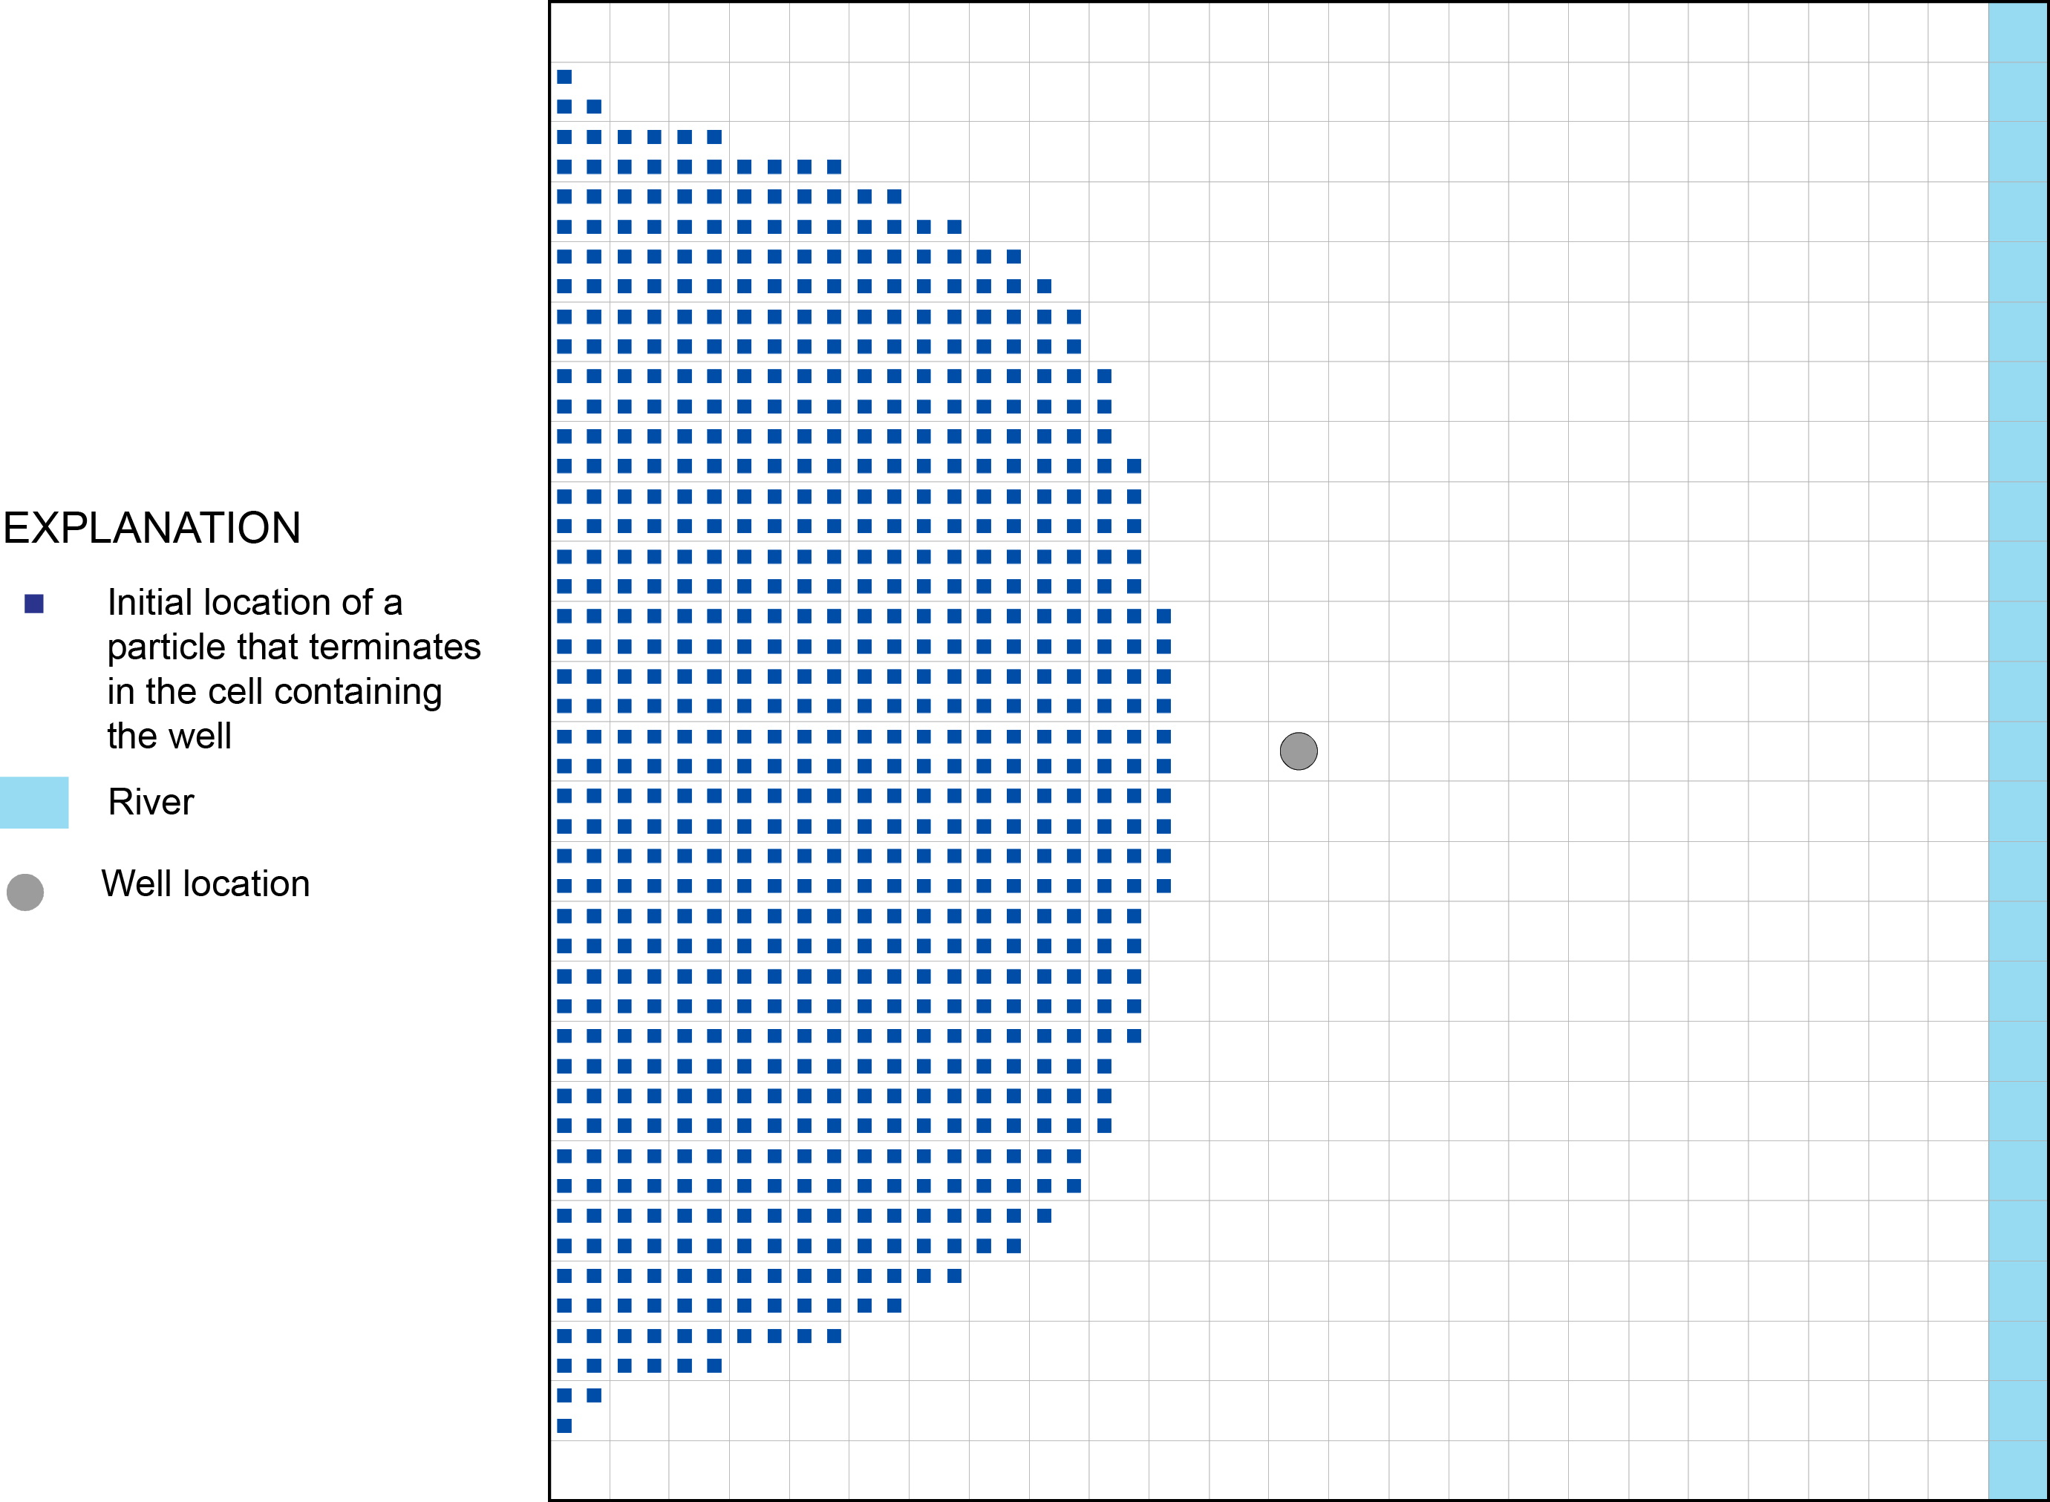
Endpoint Simulation
Information about the initial and final locations of particles are stored in the endpoint file

Slide 13
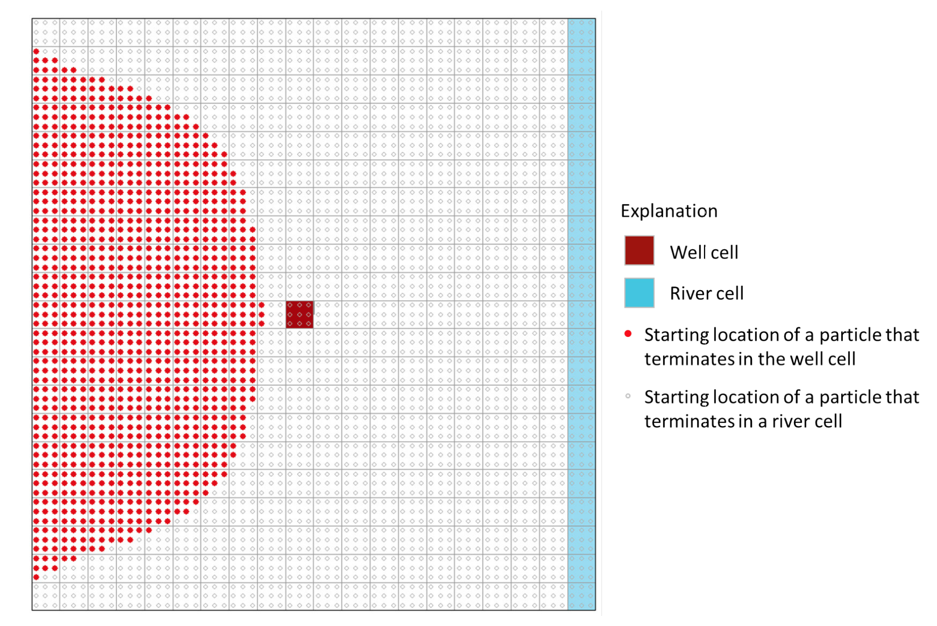
Endpoints

Slide 14
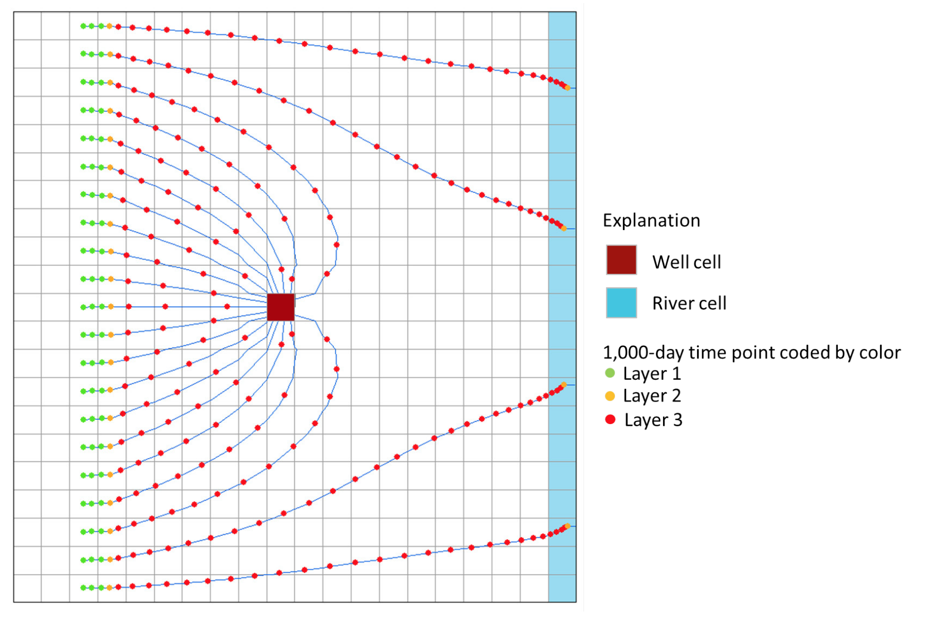
Pathlines

Slide 15
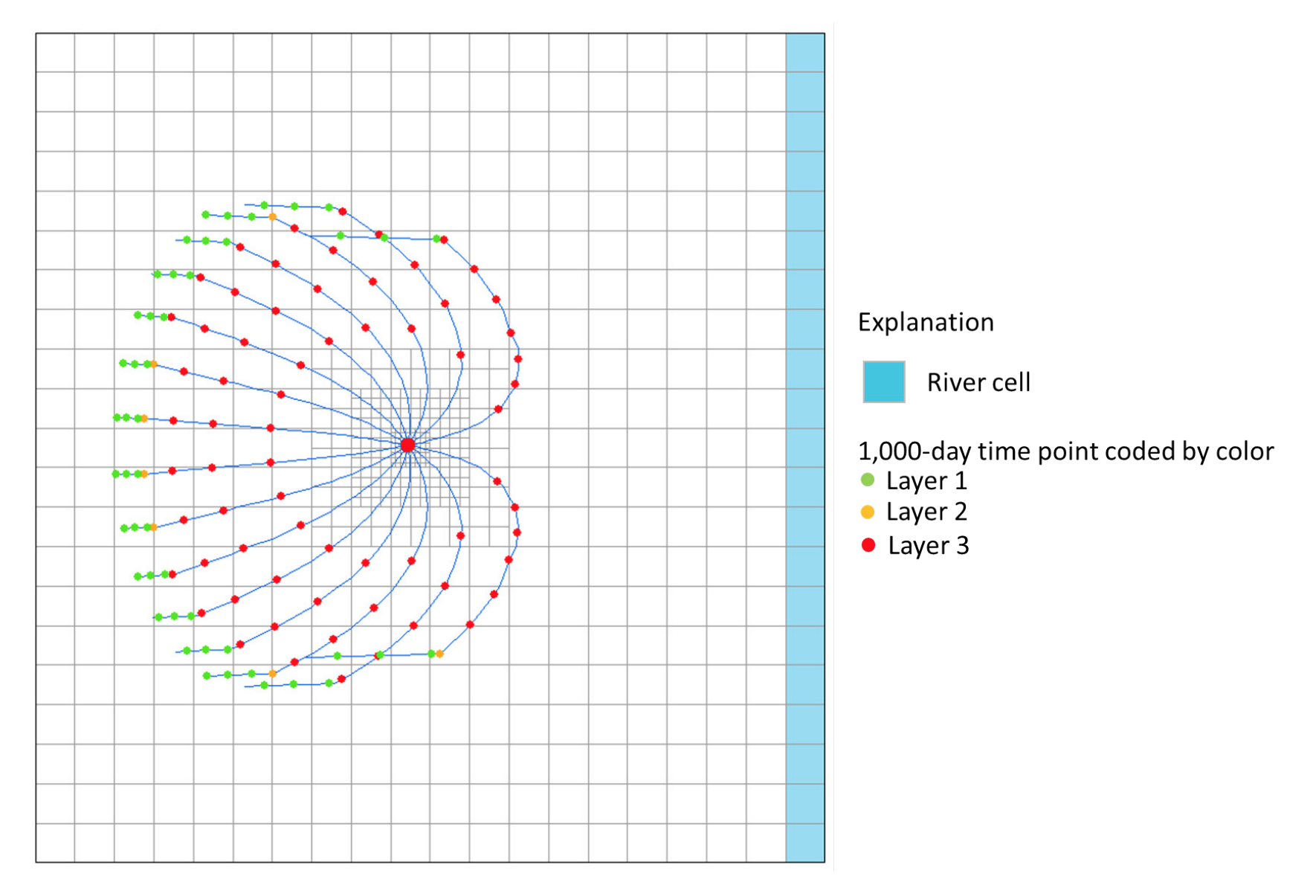
Unstructured Grid

Slide 16
